Slide 1
Extraction Rules
Day 2 - Chapter 2

Slide 2
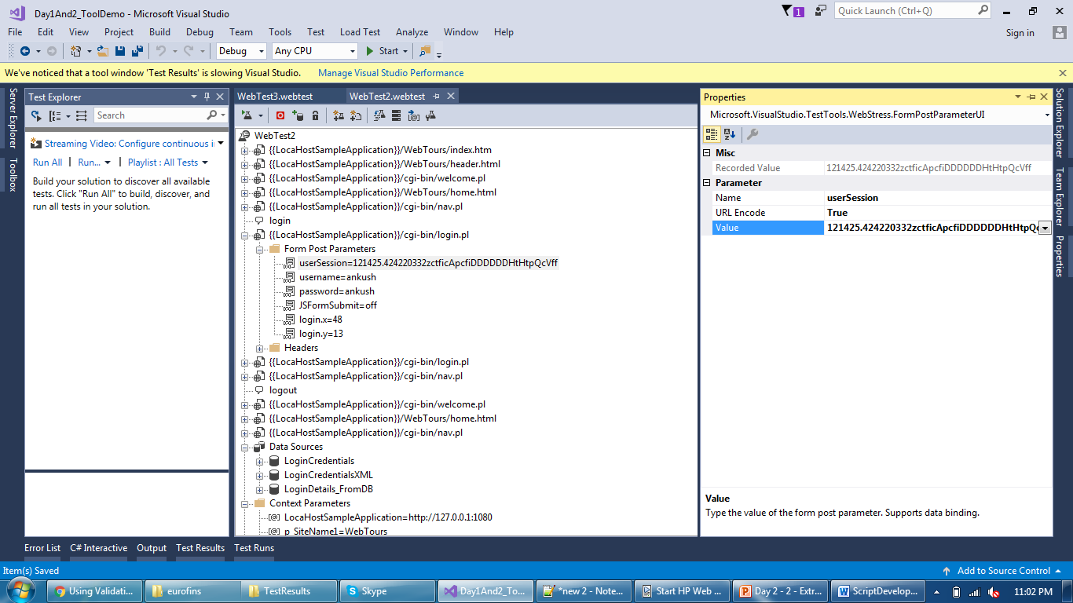
Extraction Rule
Identify dynamic value which needs to be extracted

Slide 3
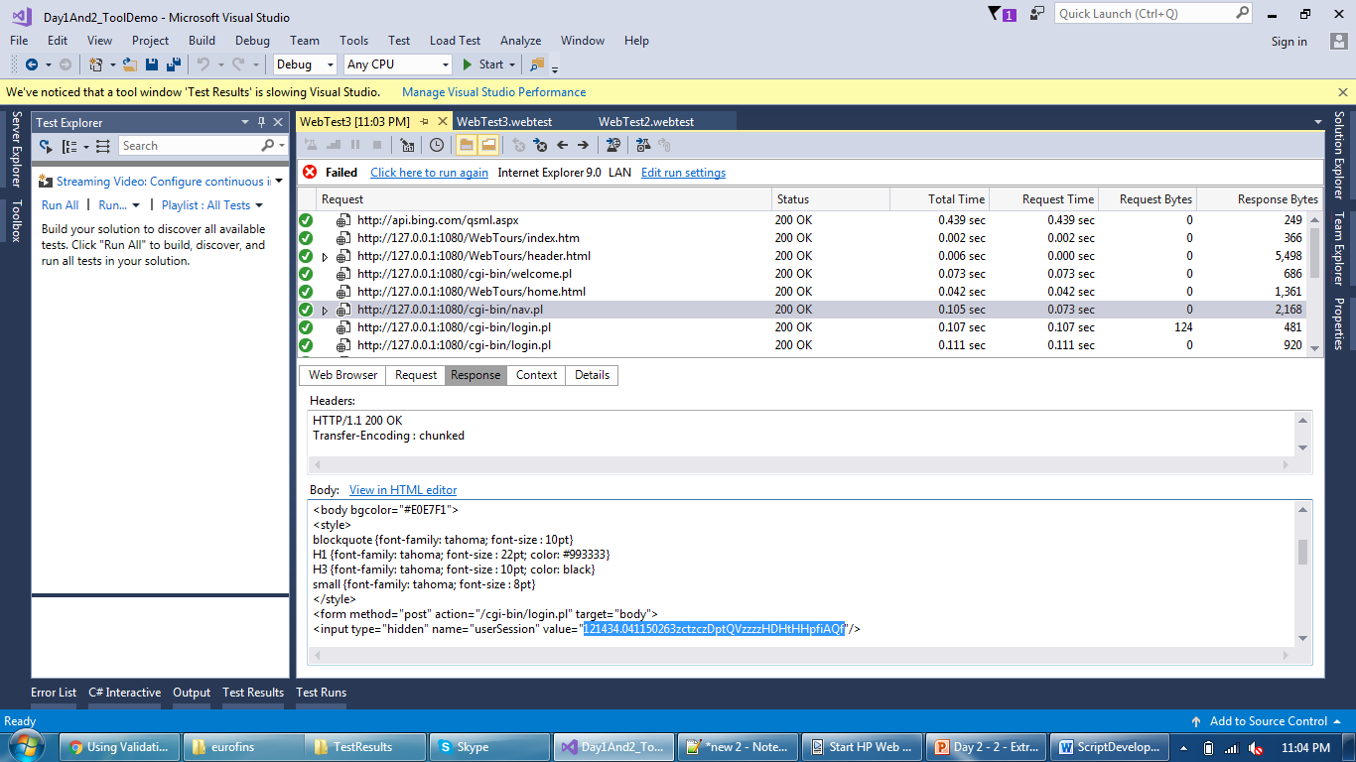
Extraction Rule
Identify response of a request where dynamic value exists

Slide 4
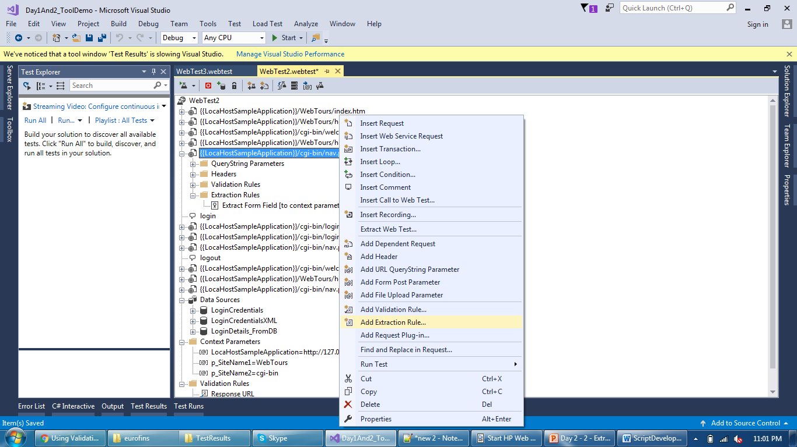
Extraction Rule
Add extraction rule to that request

Slide 5
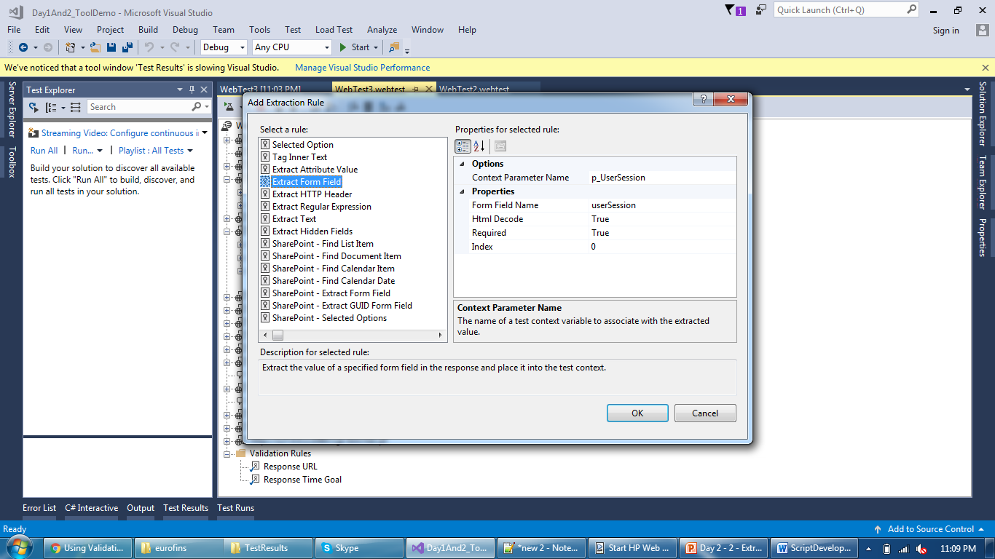
Extraction Rule
Add extraction rule to that request like “form field”

Slide 6
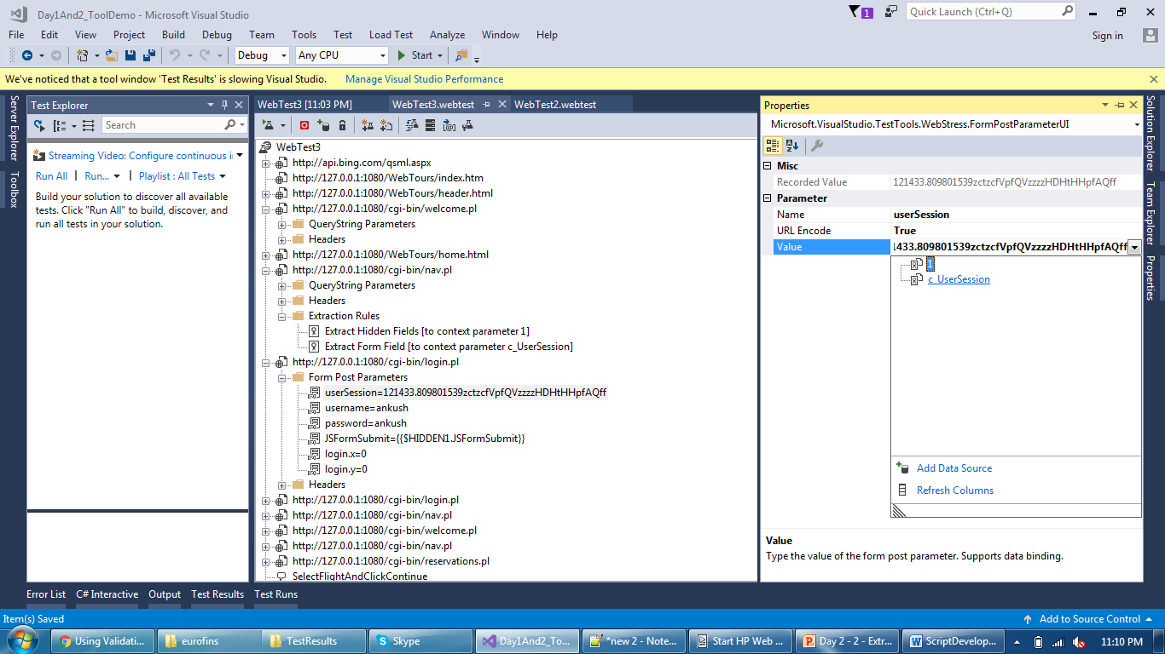
Extraction Rule
Replace the value with the captured extraction parameter

Slide 7
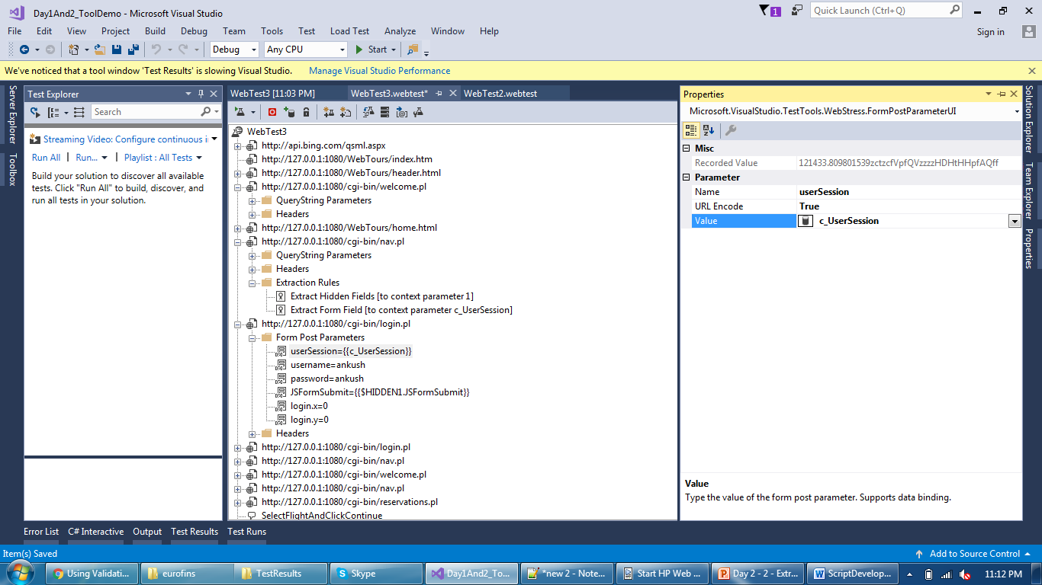
Extraction Rule
Parameter is kept in {{ }} and can be find & replace in all req.

Slide 8
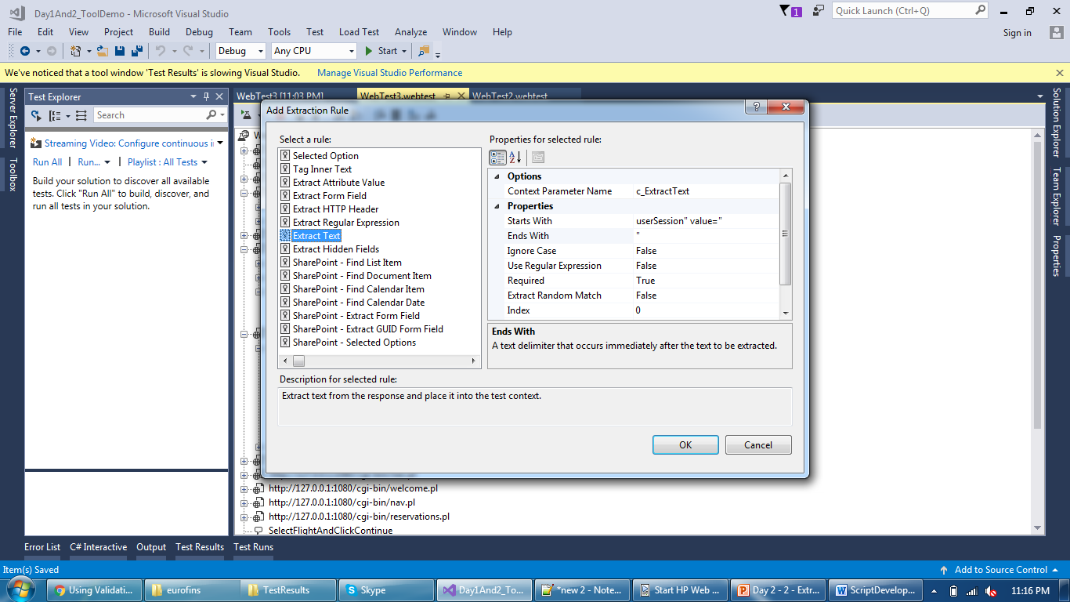
Extraction Rule
Extract text needs left and right boundary of a text to capture

Slide 9
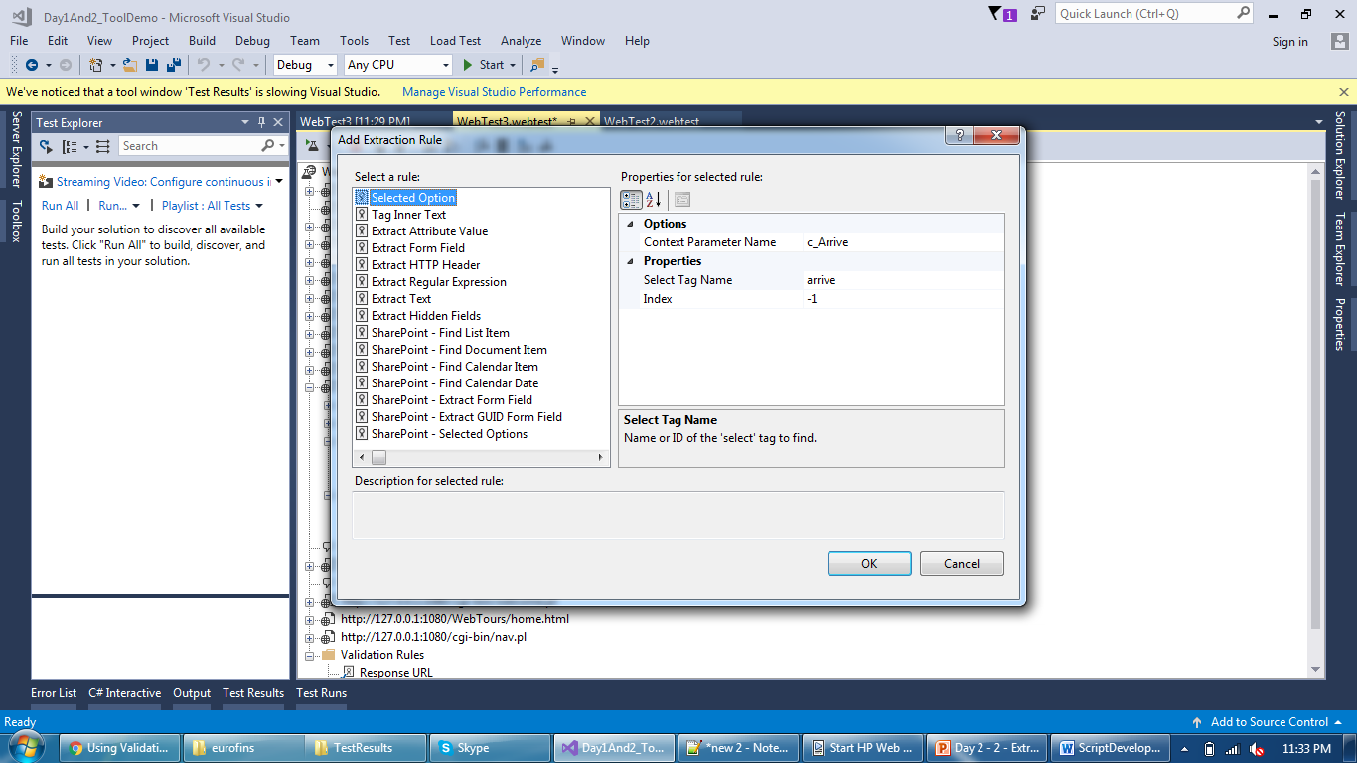
Extraction Rule
Extract a value of a Option

Slide 10
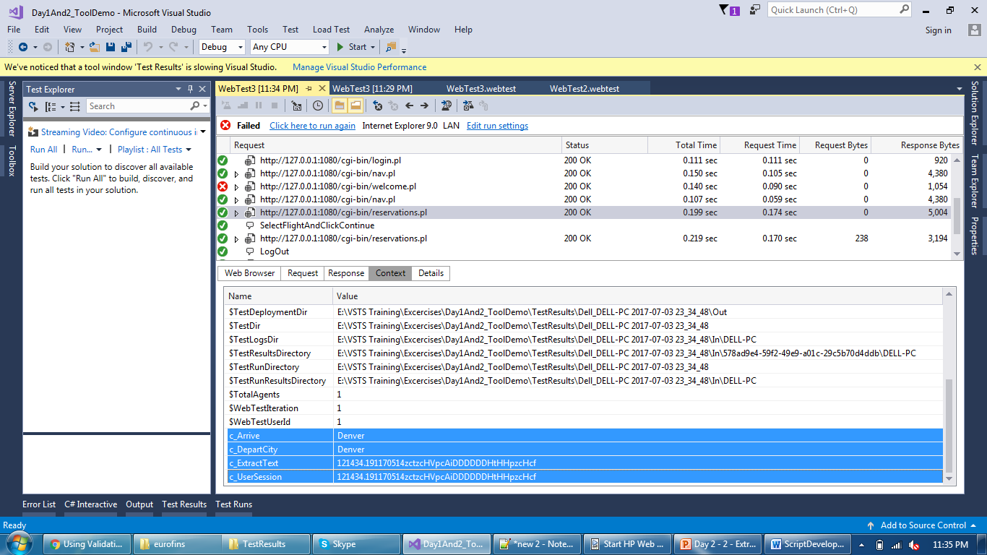
Extraction Rule
Verify all extraction rule in Context tab of results

Slide 11
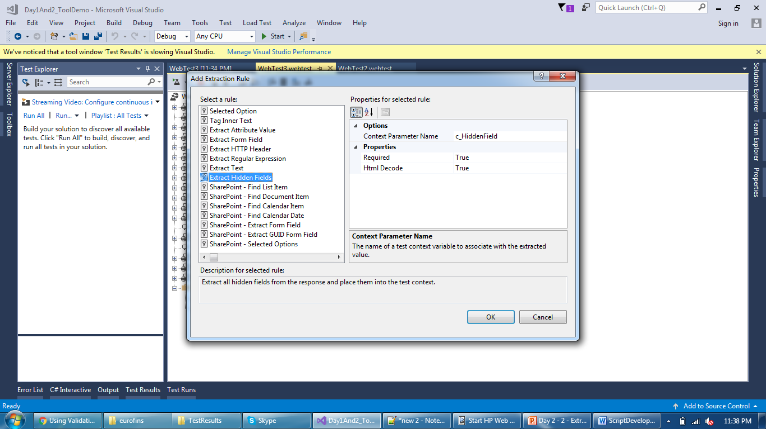
Extraction Rule
Just need a Context Param name, it extracts all hidden fields

Slide 12
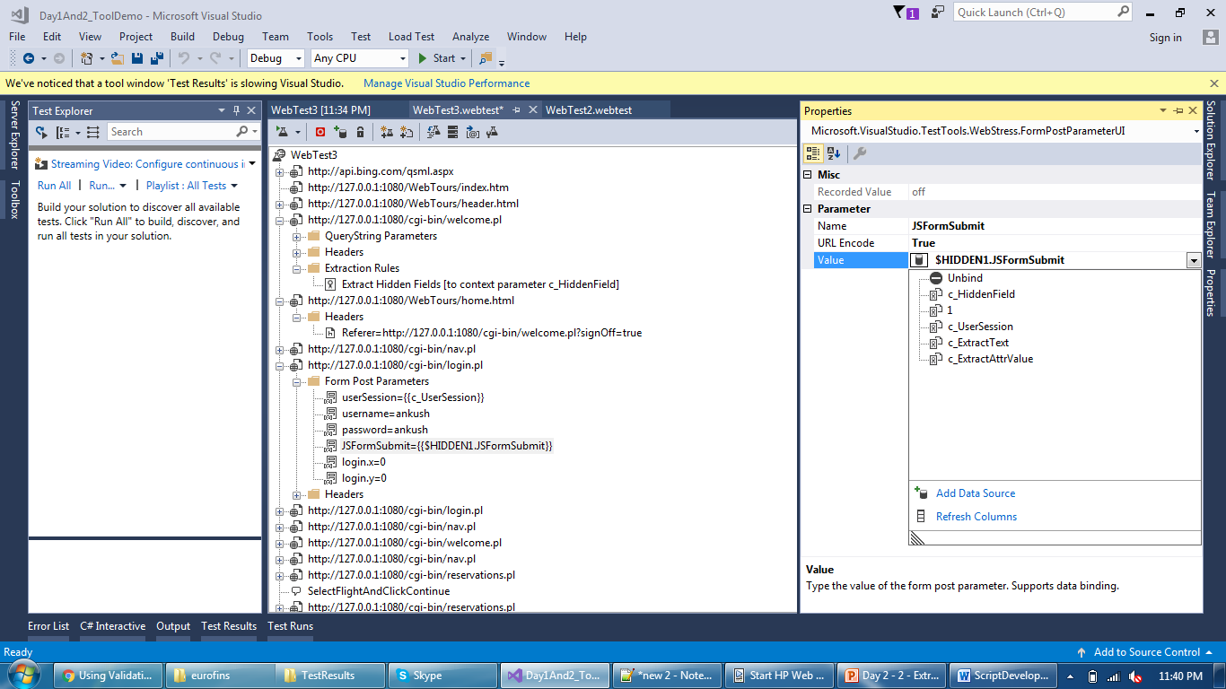
Extraction Rule
Hidden field are replaced by {{$ParamName.FieldName}}

Slide 13
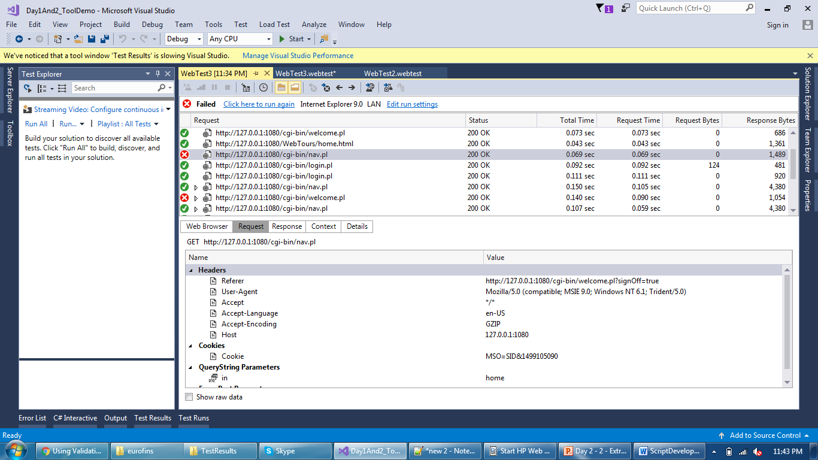
Extraction Rule
Locate Header you want to extract

Slide 14
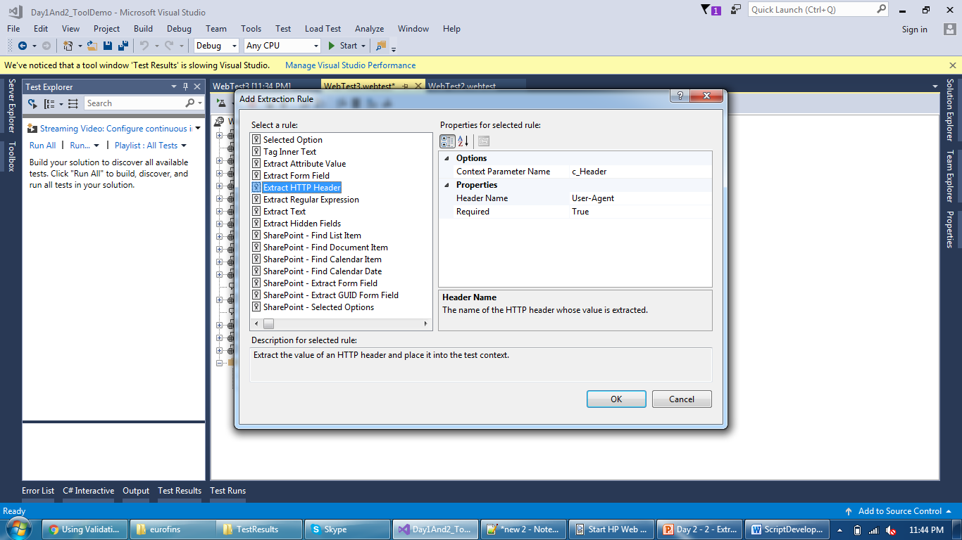
Extraction Rule
Just need header name who’s value needs to be extracted

Slide 15
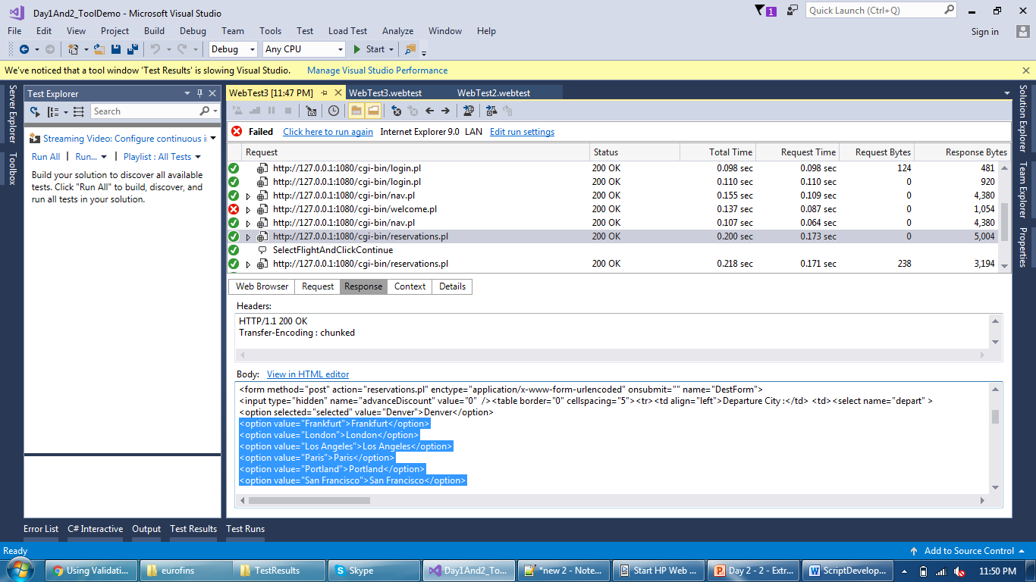
Extraction Rule
Regular Expression is useful when no unique pattern applicable

Slide 16
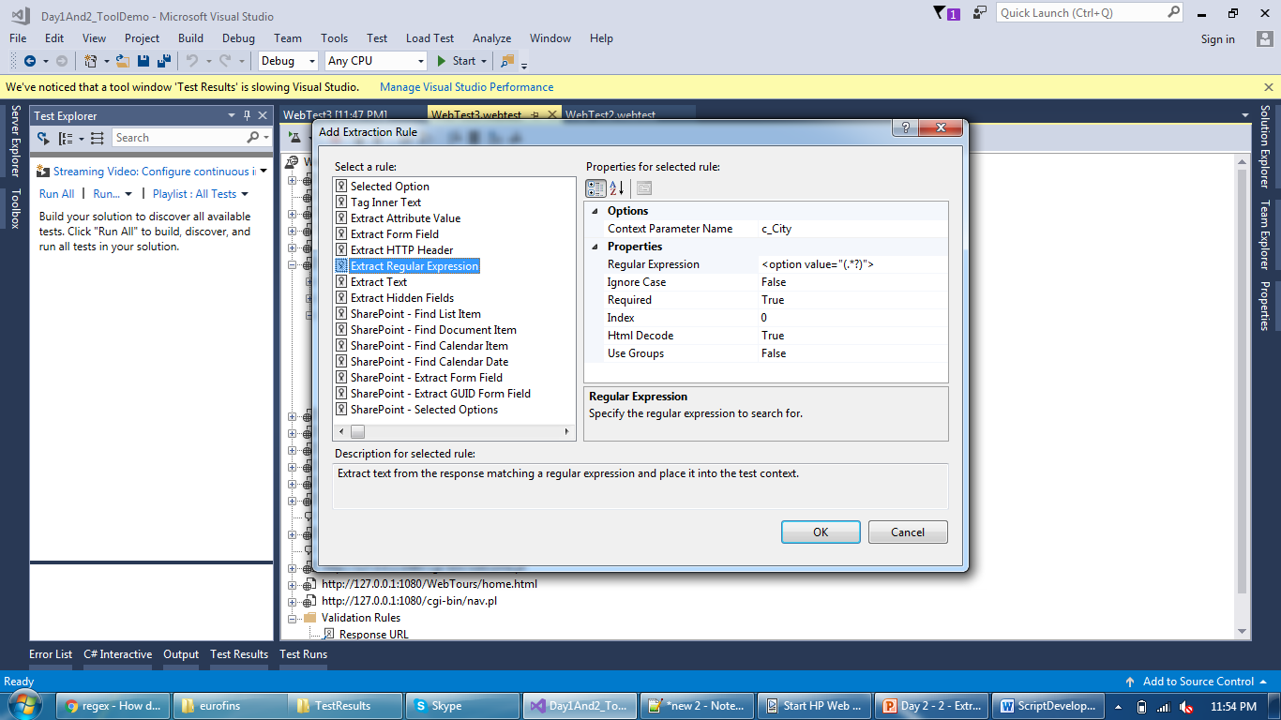
Extraction Rule
To fetch any type of data use (.*?) in regular expression

Slide 17
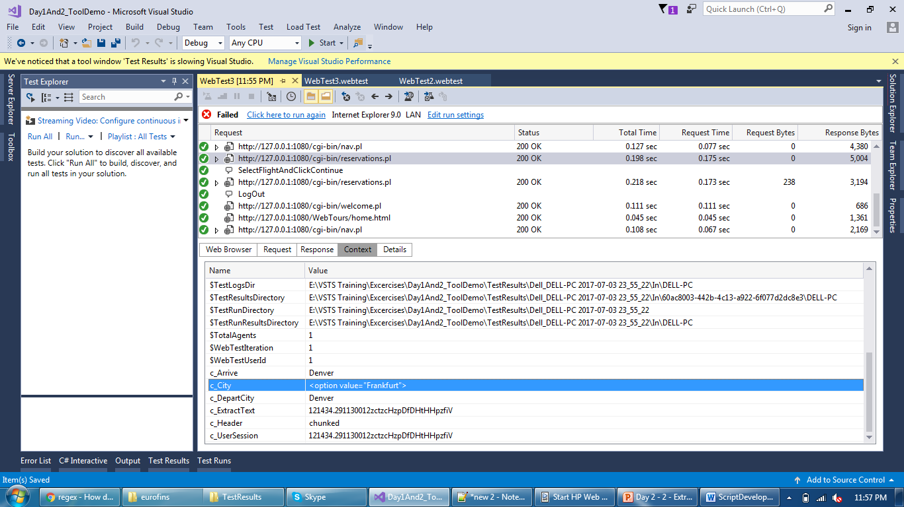
Extraction Rule
But it will capture entire string instead of only (.*?)

Slide 18
Extraction Rule
Many examples on sample application and RegEx website
www.regextester.com/
References
WebTestRecorderPlugin base class or codeplex.com\teamtestplugins
https://blogs.msdn.microsoft.com/edglas/2010/03/23/web-test-authoring-and-debugging-techniques-for-visual-studio-2010/
Running a JavaScript in Coded web test
Or on more example of “fields modified by JavaScript”
https://msdn.microsoft.com/en-us/library/ms364082(v=vs.80).aspx

Slide 19
Thank You

